Slide 1
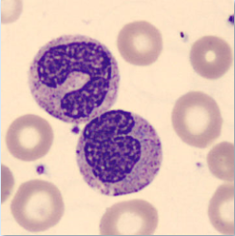
Getting started with AI & Computer Vision
A guide of obstacles & insights from the field
Notes:
Hello and welcome. Thank you so much for joining my session today: Getting Started with AI & Computer Vision: A guide of obstacles & insights from the field.

Slide 2








Kristina Mishra https://www.linkedin.com/in/kristina-mishra/
Notes:
My name is Kristina Mishra. A quick background about me:
I’ve been a data professional for over 20 years. I’ve held titles such as Data Architect, DBA, Consultant, Developer, Manager, Coach, and many more.
Some of my favorite projects have been working with the CDC, working for CSC for the World Trade Center Health Project, and multiple global health Pepfar projects.
I was a volunteer organizer for SQL Saturday in Atlanta for over 8 years and for the induction year for SQL Saturday BI in Atlanta.
Recently I went back to school to get my masters in Business Analytics – studying both the leadership and technical sides of Data Analytics, and following that, decided that I wanted to start getting some certifications under my belt.

Slide 3

Background
Meme create from original work of Allie Brosh
Notes:
To start off with, a little background on how a 20+ year SQL Server data professional ended up doing computer vision.
A few years ago, I took some time to myself and then decided to go back to school and get my masters degree. Because it turns out, relaxing and doing home projects is not a good fit for me.
I always wanted to go back to school, and I convinced myself it was perfect timing (nevermind covid19 would hit shortly afterwards and I would be doing my degree while also teaching my young twins for 18 months.) ..
After taking a course from the Industrial Engineering department, I saw a course titled Advanced Analytics Projects. This class was for a few graduate students to work directly with a company on an analytics project. There were 3 of us, and we had our choice of projects. I can’t disclose the exact projects, but they were something like
1.) Predict performance of an item over multiple years
2.) Design a method to suggest optimal locations
3.) And a computer vision project: identify and estimate the percentage of similar objects within an image.
I had zero experience with computer vision, ,and honestly had to google it . IT SOUNDED REALLY COOL. Never having let a thing like “experience” stand in my way – as a data professional my entire career has been “hey can you learn this new thing really fast and implement it?” - so OF COURSE my vote went to the computer vision project.
Turns out so did the other 2 students – it was unanimous! And these were super smart Industrial Engineering grad students – so surely we would be fine. What could go wrong?
Turns out NONE of us had experience in computer vision …and our collective experience in python at the time wasn’t much better.
Somehow we did it. We all had to work like mad – but we did it and learned a lot along the way. So much, that I decided to frame my capstone project along similar lines – because, I could take it to new directions and explore things further than we were initially able to do. Again What could go wrong? And that brings us to this presentation. So this session goes through some of the major things that DID go wrong.
And hopefully, you will have a takeaway from this session that helps you avoid or alleviate some of the pain points that I went through, should you decide to embark upon a computer vision project in the future.

Slide 4
What does it all mean???
AI
Machine Learning
Neural Networks
Deep
Learning
Computer Vision
Notes:
Before we get into what went wrong,
we need to back up for just a moment and explain some broader terms.
First, let’s talk about “what is AI?”. Artificial Intelligence, or AI, is a term we hear all the time in news stories and often in data discussions, but it isn’t always clear. AI is a term used to describe machines that have intelligence. A machine capable of solving a specific problem.
Moving down from AI, we see that Machine learning is a subset. Machine Learning is a particular type of AI where the machine learns by itself. And the machine uses data to improve performance in learning. It’s one of those fun terms in IT, where the name is pretty descriptive – teaching a machine to learn.
Moving on to neural networks, this is a system that mimics the human brain. Things go in, you learn, you learn from your learning. This may be repeateded many times over, and you give an output.
A simple neural network may have 3 layers: an input later, a hidden layer, and an output layer. They also have a something that is called weights that connect everything and facilitate in learning.
It’s got some maths to it, but really that’s the gist.
Then we have deep learning. The “deep” in deep learning is referring to the depth of layers in a neural network. The “how many times you are learning from the learning”. A deep learning neural network will have more than one hidden layer. So it really has the capability to learn more and to learn from its own mistakes. Think of it like a toddler that touched a plug and get a small shock. The toddler is probably going to conclude that plugs are bad. Versus an adult, that may have a much deeper understanding of electricity. The adult has learned a lot more along the way.
So what is computer vision? Computer vision is largely a subset of artificial intelligence, and it gives a system the ability to potentially acquire, see, understand, and analyze image-type input.
Part of CV falls outside the AI group as it can also involve some things that you wouldn’t traditionally put under AI like image manipulation. If I take a bunch of images and change them to greyscale, that’s not really AI, but it may be important part of a process for an image dataset I’m using in my computer vision project.

Slide 5
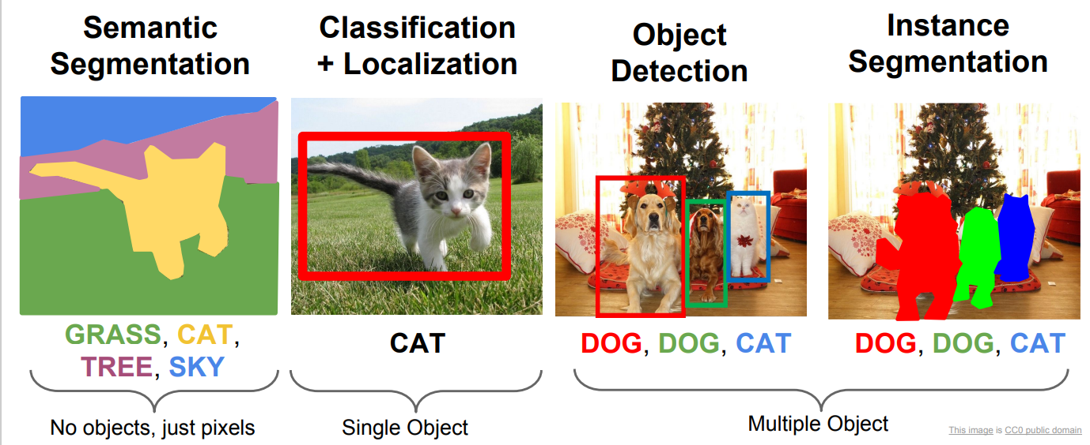
Some Computer Vision Tasks
http://cs231n.stanford.edu/slides/2017/cs231n_2017_lecture11.pdf
Notes:
Here is just a few different types of computer vision tasks.
In the first picture you see that every single pixel has been assigned to a category. Green for grass, yellow for cat, pink for tree and blue for sky. This is called semantic segmentation.
If I had 3 cats in this image, they would all be yellow. That’s why all the trees you see here are pink.
The second image is 2 things: it identifies where the object is and classifies it. So maybe in this instance it would tell you that for this object, it puts that the object is a cat at a 90% chance, fox at 5%, squirrel at 3% and dog at 2%. Something like that.
In the 3rd image there are multiple objects, so kinda the same thing as the second image, but having to identify multiple things and sometimes multiple objects of the same thing --- like the 2 dogs here.
In the last image you are identifying exactly where the object is and putting a mask on it to identify each pixel in the mask. Some similarities as the semantic segmentation, I could have also labeled the entire image like you see in picture 1. The difference is, that each object is its own thing, even if the category is the same.
There are other tasks, but gives a good starting point. A project may just use one of these, or multiple if it was comparing to see which is better. In my project I used Semantic segmentation, but I could have used Instance Segmentation, and that would make for an interesting comparison.

Slide 6
Key Terms With Images
Ground truth
Annotation
Contour
Notes:
Some key terms. I’m going to front load you here with a bunch of key terms that were used in my computer vision projects and will be relevant in just a bit. So bare with me. I know it’s a lot.
Key Term 1 is in the center here and we will refer to this as Annotation. It’s about manually identifying each object in an image and labeling it accordingly. The image you see here was annotated with an open source product that let’s you manually draw edges around an object and then label each object. And later on I’ll show you a quick demo on it. In this image you see roughly 17 objects that were identified and labeled. Then, depending on how you made these annotations, you can create outputs that a computer vision system can use to understand an image’s content.
Key Term 2 is called Ground truth. A ground truth image is often an output of the annotation process. In the context of a GT image, it is used as a mirror image to the original, to let a system know what is what. That labeling you did in the annotation process now becomes its own image. Imagine a system going pixel by pixel between an original image and a GT image and learning by comparisons. Pixel 1 in this image looks like this, pixel one in the GT is black which means background. Got it. Move to pixel 2. While this would be an incredibly slow process for a person, obviously a computer can do it faster and it starts to learn the different subtleties of each pixel. I’m using pixel here as an example, but there are other ways to do it as well.
Key Term 3 is a much simpler concept and frankly it’s not always used – BUT it’s a REALLY good thing to know: and that is a contour. A contour is simply drawing the edges around an object. It’s the contour of the object. You can get this information multiple ways and if you look in my github, you’ll see an example on how to build a contour image like this from JSON annotation outputs. Contours are common in computer vision, but you won’t always have to produce an image like what you see here. When you do, it can sometimes be kinda tricky to produce it, so knowing the concept and the term is really helpful.

Slide 7
Key Concept: Splitting your data into sets
Train
Validate
TESt
Notes:
Splitting a dataset is another important concept in Machine Learning and really in a lot of different statistical applications.
The basis of it is that you want to keep a different set to train on, to test on, and to validate against. By doing this, you keep each set independent. That way too, you aren’t giving cheat sheets to the model.
You start with 1 set of images. And then you typically split them into 3 sets: training, validation, and testing. Some people only do 2, and there are other methods as well, but knowing what we are talking about here will help you as you run into those other scenarios.
Your training set is usually your largest set. This is what your model “trains” on.
Your validation set is used to see how well your training set learned, and then you can tweak some parameters to see if it helps the learning process. You want to make sure you don’t overfit the model though. What that basically means is that you want your model to be able generalize and not just fit data exactly to the information you have given it.

Slide 8
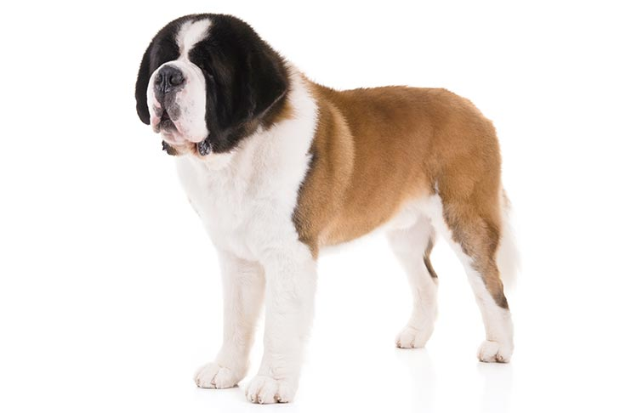
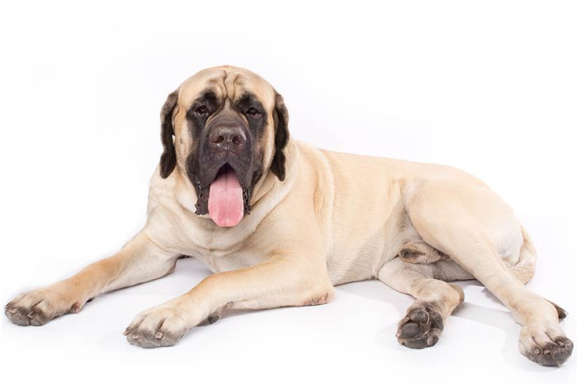
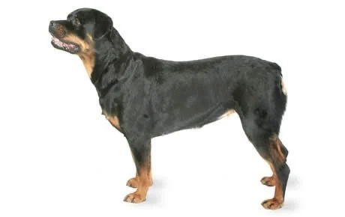
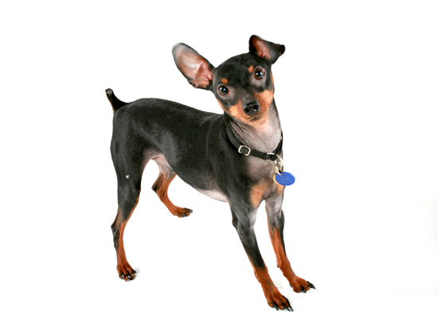
Key Concept: Splitting your data into sets
Train
Validate
TESt
Notes:
So what do I mean by generalize? For example, if I want my system to learn what a dog is, and I give it pictures of St. Bernard's, Rottweilers, and Mastiffs – if I tune my model too much to those dogs, then it may miss the adorable Min Pin I give it in the final testing phase. That’s basically the concept of overfitting. Only knowing the big dogs. Generalize is being able to take the information from the big dogs and abstract it to dogs that may look different.
Your last set – test set, is the most important one. This is the pictures you have kept completely separate (which you should have done for all sets) . After testing with your training set against your validation set, you want that 3rd set that has not seen the light of day, so you know how good it really is. Maybe your model was tuned too well, where it really worked well for your validation set – those big dogs -but not for any other set in the world. That final testing set will generally bear this information out. The test set give an unbiased estimate of the skill of the final tuned model.

Slide 9
Key Concept: Splitting your data into sets
80/10/10
70/15/15
60/20/20
Notes:
Along those same lines, you typically will split your train/test/validate sets in percentages. You want the bulk of your data to be part of your training set, so it's given a higher percentage than the other sets, and then the remaining data going to your validation and test sets.
Here are some typical splits of sets. Now, it doesn’t have to be exact, and there are some programmatic ways you can do it, but these splits are pretty common.
For an 80/10/10 split, that means that 80% of your images would go to the training set, 10% to validation, and 10% to test. You could also do numbers such as 75/15/10 – with the idea that you are trying to end up with 100%.
In a lot of cases in CV, unless you have just gobs of images 60% is not going to be enough to train. Conversely if you are working with a small dataset and you don’t have the option to get more, than you should consider leaning towards the 80% split. You have to play around with it a bit. Ultimately, if you don’t have enough images, you are just not going to get great results.
And unfortunately there is no magic number – it really depends on what your model is trying to do.

Slide 10
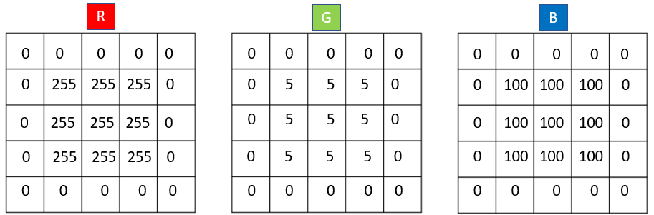
Key Terms: Channels
(5,5,3)
(W,H,C)
Notes:
Last key terms before we jump into the fun.
When I did my first computer vision project, I remembered the concept of an image having what is called channels. I remembered at a basic level the concept of channels with RGB or B&W, but not really beyond that.
In CV terms, an image is an array that has at least a width and height dimension but often has at least one more dimension, such as RGB color. I’m going to use the example of RGB channels here, but know you are not just limited to that option: an image can have multiple channels that can mean different things.
If we had a 5x5 RGB color image - than the shape of this image would be (5, 5, 3). In this example, the 3 represents a color dimension that gives a numerical value for Red, for Green, and one for Blue for the size of the width and height. So here our 5x5 image has a 3x3 square inside it with a red value of 255, a green value of 5, and a blue value of 100.
The square at the bottom you see here is a smaller scale of what this would look like as an image. The 0s you see on the top for all channels, when combined = the color black. And 255 for red, 5 for green, and 100 for blue = a fuschia type color: the square in the middle. There are other color channels you can use, but this gives you the general idea. The W, H, C you see below the 5,5,3 shape, stands for width, height, and color.
Channels is a really important topic in computer vision, that could be its own presentation, so if you are interested in computer vision take some time to explore the different ways channels can be used.

Slide 11
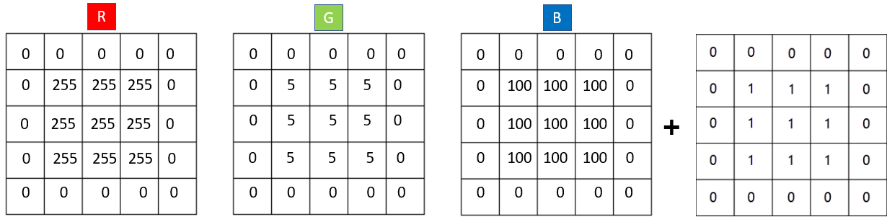
My Project
(5,5,3) + (5,5,1) = (5,5,4)
0
Notes:
My Project.
What was it?
Why did I want to do it?
What we will be walking through here is a project that I’ve done a couple times in different variations. Here I will be talking about my Capstone project because… then I don’t have to worry about non-disclosures and really because that was the project where I had a lot of gotchas that I feel can be most helpful to others.
First: what was it? The official title was: Computer Vision and using Edge Detection as a Fourth Channel.
What does it mean by fourth channel? Going back to where we previously talked about that 3-channel representing a shape of (5,5,3) and now we are going to add that contour edge image we talked about which has a shape of 5,5 or 5,5,1, with the numbers being 0 or 1 to represent the edge. So we are going to concatenate that contour image with the original image, which in our example would result in a shape now of (5,5,4).
Why did I want to do it? To see if adding the contour would improve results for identifying blood cells, particularly with overlapping blood cells. Overlapping objects that have similarities is an ongoing problem in computer vision that does not have a silver bullet solution yet. By using blood cells, the ideas, code, and learning models could be used in other industries.
A second part of the project was to be able to accomplish the various steps with low-cost solutions, so that stakeholders in global health worldwide may be able to use part or whole of the project without running into significant costs.

Slide 12
The 3 Stage Process
Data
Model
Results
Cleansing
Augmenting
Split
Make More
SegNet
HED
Integrated
Record
Evaluate
Make More
Notes:
Given I had a hard deadline for my project - I needed to determine the steps I COULD take, and then decide which were required, which were nice, and which brought value given the expected effort. Note, I had done a similar project before with a small team for a client, so I wasn’t going in completely blind.
That brought me to this 3-stage process: I personally like to divide them into these 3 categories: Data, Model, Results. Notice the double-sided arrow at the bottom – that really signifies that these items aren’t done linearly. Obviously, you couldn’t start with “Results”, but after getting results or even while running your models, you may have to jump back to the data stage and revisit things. Which has happened to me many many times.

Slide 13
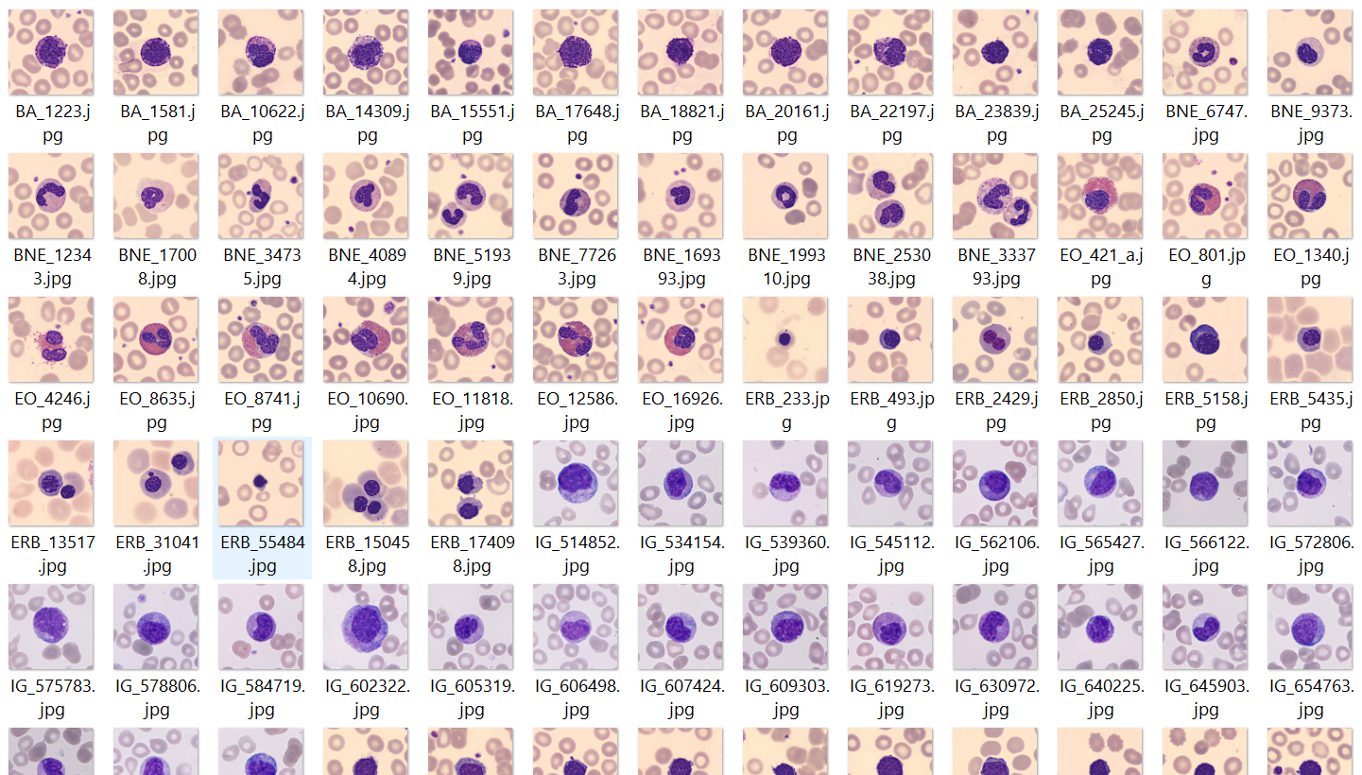
Dataset
Dataset
Notes:
The first step was acquiring the data. You can’t really do anything until that is in place.
The primary dataset I used is a subset of the microscopic peripheral blood cell images made publicly available through the collaboration of The Clinic Hospital of Barcelona, The Technical University of Catalonia, and the University del Rosario, Bogota. This set has over 17K images, I used MUCH LESS.
Images were obtained at the Core Laboratory at the Hospital Clinic of Barcelona and consist of red blood cells (RBC), white blood cells (WBC), and platelets. The images were annotated by expert clinical pathologists and organized into eight groups. The class ids 2-9 in this table are the classes that were identified in the original dataset. The other classes: background, RBC, and RBC_ol are ones I added, because my project wasn’t trying to identify a singular cell within an image, but rather all the objects within each image.
The majority of images were sized at 360 W x 363 H. The description file stated ALL of the images were of this size, but I later found there were a small number that were a different size, so before we even get into problem # 1, I’ll say first do some verification steps on your data. Don’t automatically go by what the documentation says, or even what anyone else says. You definitely want to verify something as crucial in computer vision as size, because a lot of times you are going to need your images to all be of the same size.

Slide 14
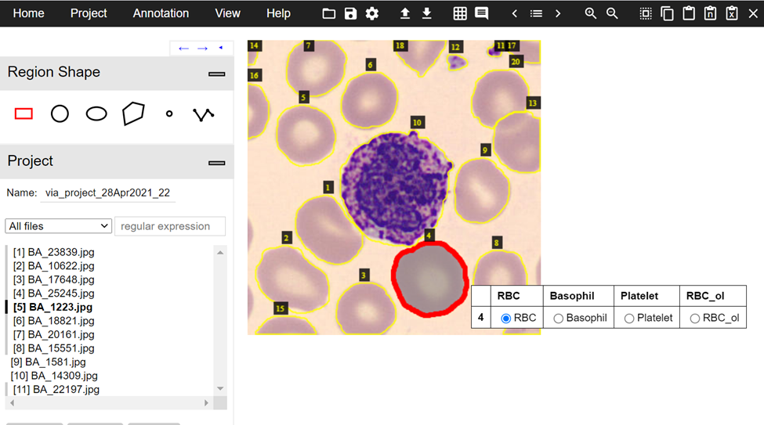
Problem 1: Annotations
Notes:
The original information with the dataset stated that the data was annotated. My experience with annotated images came from the open-Source project VGG Image Annotator (VIA), which you see here. It’s a simple program, that opens up in your favorite web browser and you don’t have to install anything. You see the outside lines of each object, which is referred to as polygons. So if I was annotating something from scratch <flip to VIA>
<<<<<I’d have already declared my categories, I’d click points around an object like so, until the polygon was closed, and then assigned the newly created polygon to one of the categories I previously defined.
This pretty much was my idea of what annotation was. You can import or export the x/y coordinates to a csv, json, or coco file. Here’s an example of a JSON export. Some programs will do this in other formats, such as xml.>>>>>>>>
So that’s what I expected with the annotations included with the dataset. Some sort of file that I could pull into VIA, maybe have to tweak a bit, and then POOF all my little polygons would appear and I can export my required VIA json file. I needed that JSON format specifically for my downstream process that created those contour images we discussed earlier.

Slide 15
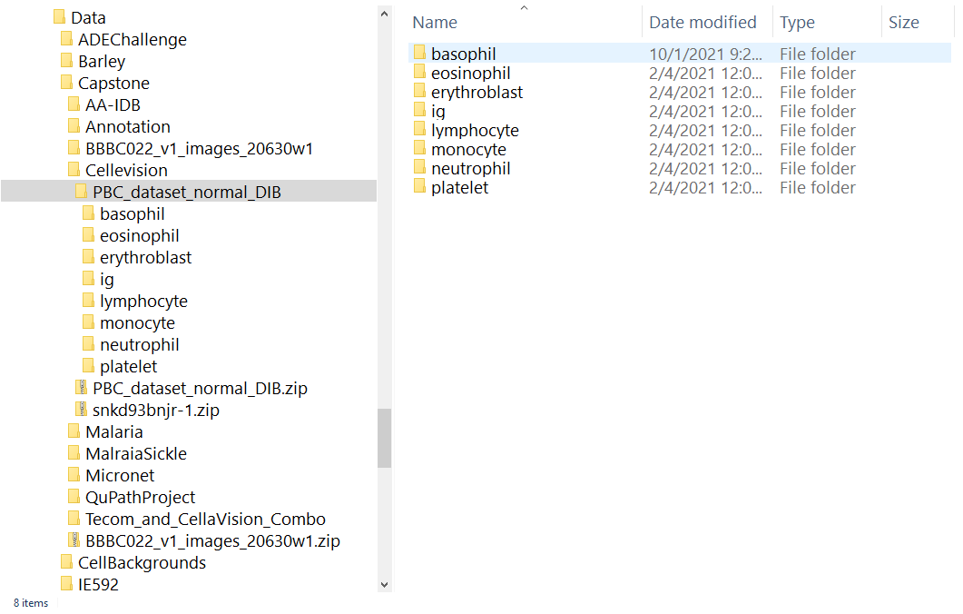
Problem 1: Annotations
Notes:
This is what I got.
A directory structure

Slide 16
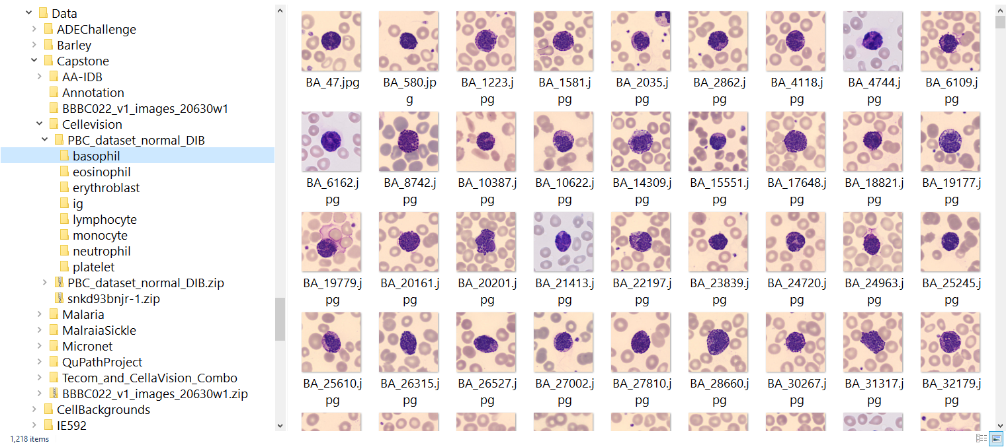
Problem 1: Annotations
Notes:
Where each image was placed in 1 of 8 folders, that was determined by the largest dyed cell in the image. For example, this folder contains all images where the basophils where front and center.
No identifying file that told me the x and y points defining the polygon of the basophil – or anything else in the image. Nothing.

Slide 17
Problem 1: Annotations
Notes:
So I had to go back, and start annotating each object by hand. I think my first 10 images, took me about 45 minutes FOR EACH IMAGE.
Clearly that was not going to work. And my 17k image dataset, was probably not going to be that big if that was my rate per image.
I then got to delve into the wonderful world of annotation software looking for a faster solution.
I had a second problem and that was I needed to be able to create ground truth images. Somehow, I either forgot that this was needed, or assume it was included or could be easily generated, but the final result was I didn’t have them. So I needed 3 things ultimately from a SECOND annotation application:
1.) quickly create annotations on the image
2.) generate output that was compatible with VIA import (becz of downstream process already developed)
3.) generate ground truth images
I installed program after program. I even reached out to a couple of the paid programs for student discounts (which they graciously gave me free for a period). I installed docker and got to learn (and debug) issues with that. Many programs I tested had additional “add-ons” you had to install to get even close to what I needed. I even tried a couple times to programmatically make a solution that I could use with one of these programs, but IT WAS NOT HAPPENING. I was going down an entirely separate rabbit hole that should have been its own capstone project.
It took me about 2-3 weeks of learning, testing, and debugging of various solutions to get to my annotation requirements.
Ultimately, I was able to find my software – though I still had to write code for some things related, but the big takeaway was that there is not one “standard” definition of what “annotation” is and many of the different outputs from various annotation software products are not compatible with each other. AT ALL. So if there are downstream processes that have any sort of dependency, you really need to make sure that you account for that.
Now almost 8 weeks into my project – I was still only in the data prep/cleaning phase and my clock was running out.
With the new software, I was able take my 45 minutes per image to about 5-8 minutes per image – and it made the annotations and ground truth images that I needed. Given the time spent on all these activities, my buffer for my project was greatly reduced as was my dataset.
At some point, I realized I needed to move on to the next phase with what I had and then circle back if needed. I still had not create the contour images or tested these images in my networks.
What was the final number of the baseset of annotated images?

Slide 18
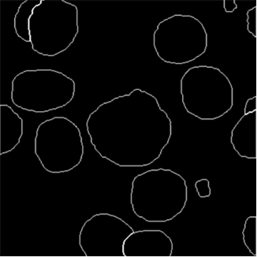
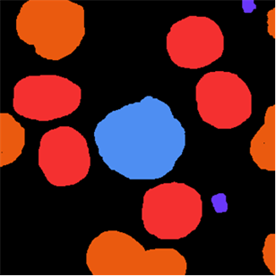
Problem 1: Annotations
Base set = 114
Notes:
114. It seemed small, but I had worked on other non-computer vision classification projects and in my sleep deprived mind, it wasn’t TERRIBLE. I was finding it difficult to find information on what was a good number for a computer vision project, so 114 it was.
The software I used made ground truth images that I needed and produced an export of the annotations that was compatible with VIA. So I could then import into VIA and then export my needed JSON files for the contour images I still had to create. The VIA export was pretty essential to creating those contour images.
Thankfully the code I previously created to make contour images – only needed minor tweeks. Finally something was going right, so I could move onto testing my now cleaned and completed dataset, with my previously tested neural networks.

Slide 19

ALERT
NEURAL NETWORKS AHEAD
It’s going to get messy for a minute
Notes:
It’s going to get messy for a minute. I promise to keep it short and high level, because this isn’t really a deep dive session into neural networks.
I’m not going to go into all the nitty-gritty details of the various networks, but I want to quickly explain a few things.

Slide 20
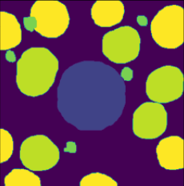
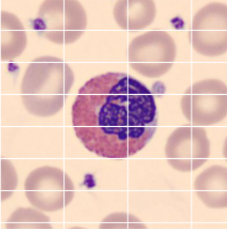
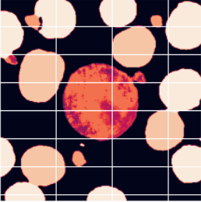
SegNet Architecture
Down
sample
Convolution
2 layers
64 channels
MA X
P
O
O
L
Conv
2 layers
128 channels
MAXP
O
O
L
Conv
3 layers
256 channels
MP
O
O
L
Conv
3 layers
512 channels
MP
Conv
3 layers
512 channels
MP
Soft
max
Up
sample
Convolution
2 layers
64 channels
MA X
UN
P
O
O
L
Conv
2 layers
128 channels
MXUNP
O
O
L
Conv
3 layers
256 channels
MUP
O
O
L
Conv
3 layers
512 channels
MU
P
Conv
3 layers
512 channels
MU
P
Notes:
This is the SegNet architecture I used. You take an image and its matching ground truth image and that is what the network uses to learn. It takes those images, get some important details, makes them smaller, repeats this process, and then makes them larger again to use in its prediction.
I used SegNet because it’s been around since 2016/2017, is stable, light, and only has a few parameters you need to tweak during the process. It’s memory efficient and comparatively easy to train.
Also, I already used a similar model, so I wanted to minimize debugging something different. My goal wasn’t to find the best network, it was to see if using a 4th channel made an improvement. So in that respects, using an older NN met my criteria fine.
------------------------------------------------------------------------------------
Since the network does not have any fully connected layers (which consume >90% of the parameters in a typical image processing CNN) it is much lighter.
SEGNET is thus very memory efficient and comparatively easy to train.
Max-pooling layers are replaced by unpooling, where the values are restored back to their original location, then convolution layers interpolate the higher-resolution image.
Softmax - function outputs a vector that represents the probability distributions of a list of potential outcomes

Slide 21
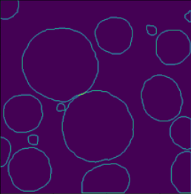
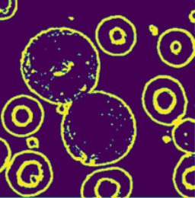
Holistically-Nested Edge Detection
Image
Contour
Conv
2 layers
128 channels
P
O
O
L
Conv
3 layers
512 channels
P
O
O
L
Multi Size Weighted Fusion
Conv
2 layers
64 channels
P
O
O
L
Conv
3 layers
256 channels
P
O
O
L
Conv
3 layers
512 channels
P
O
O
L
Bi-Linear Deconvolute
Bi-Linear Deconvolute
4 Filter
4 Stride
Bi-Linear Deconvolute
8 Filter
6 Stride
Bi-Linear Deconvolute
16Filter
10 Stride
Bi-Linear Deconvolute
32 Filter
18 Stride
L
L
L
L
L
Predict y1
Predict y2
Predict y3
Predict y4
Predict y5
h1
h2
h3
h4
h5
Notes:
This is the edge detection network I used, it is called Holistically-Nested Edge Detection. Or HED for short. It’s even older than Segnet, going allllll the way back to 2015.
Again, not going to go into the nitty gritty here, you can read the official papers on it – but I’ll give a high-level overview.
For this network you need your original image and its corresponding contour image. Remember that image that was generated from the pesky JSON annotation files in that downstream process I kept mentioning? In this instance, the contour image is the networks ground truth image. Because all it really cares about is edges. IN this network, there are predictions made through each step of the process, 5 total, and then they are fused together for a final prediction. Like the contour image, the predicted image is really just composed of a 1-dimensional array of 0 and 1s representing if there is an edge or not. This prediction is the basis of the 4th channel used in the integrated network.

Slide 22
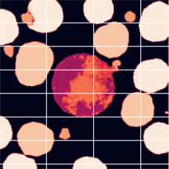
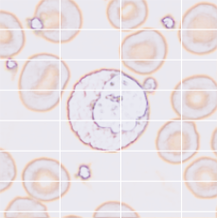
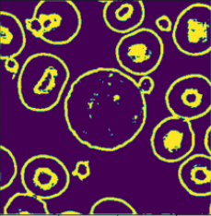
Integrated Architecture: SegNet + HED
Concatenate
SegNet
Prediction
HED
Input: Image
Notes:
And then finally our integrated network.
We take the input image and the edge image, concatenate them together to make our fourth channel image. Then that concatenated 4 channel image is feed through SegNet again (with the original ground truth) and results in a final prediction.
I had already done this before AND done pretests at the beginning of the project, so I was pretty confident that all I would have to do it sit back and let the networks run.

Slide 23
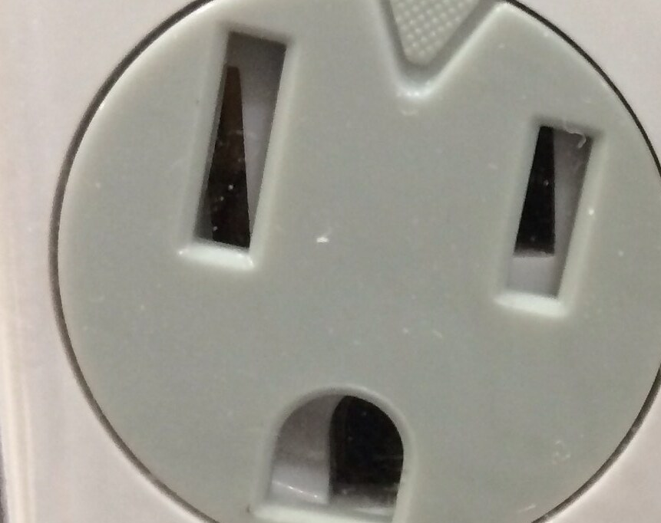
Problem 2: Neural Networks are not plug and play
This Photo by Unknown Author is licensed under CC BY-SA-NC
Notes:
Problem 2: NN are not plug and play.
Well let me clarify that, SegNet was not plug and play.
I was getting errors ALL OVER THE PLACE.
I wasn’t even to the point of testing the HED network or integrated network. I half abandoned SegNet and tried with Unet, but it was giving me similar problems.
I had used this setup before with images of a different size. My pretests involved images and ground truth images that were the same size that I had previously used when running a similar project, and they had worked fine.
So that was my first clue: one of the biggest changes from my pretests was image size. That’s where I started my investigation.
For those of you that have coded for awhile, most of you are probably aware of “the poor person’s debug tool” called “print”. I used 2 images and printed out changes of the array size as it went through SegNet.

Slide 24
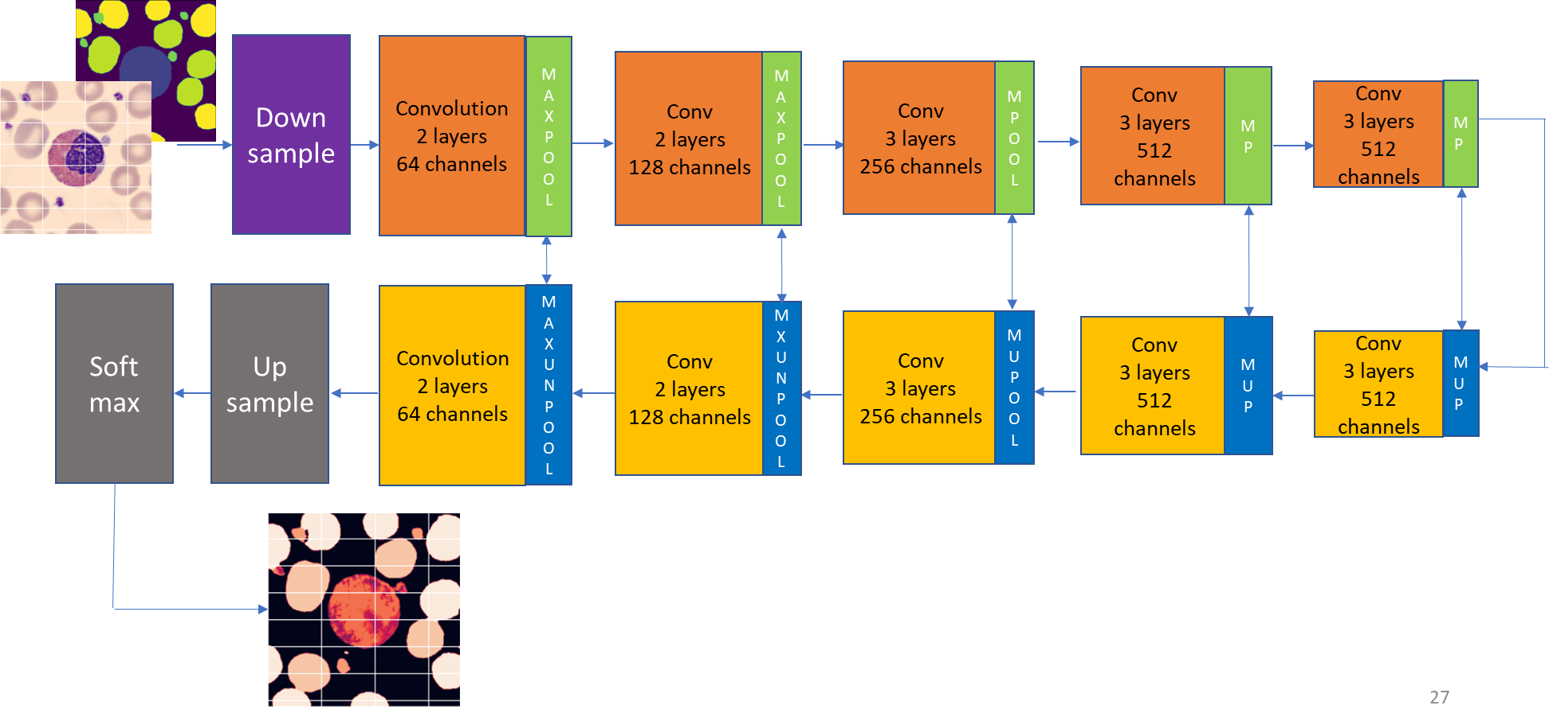
Problem 2: Neural Networks are not plug and play
Notes:
Thank goodness for “print”.
What I failed to mention before when I talked about this network, is that when you start with an image shape and then make it smaller and then bigger again, you want the corresponding shapes to match. Each stage that it gets smaller needs to match its corresponding larger size. That image size we talked about at the beginning: 360 W x 363 H, yea, the maths in my SegNet was not adding up. That 360x363 divided going down and then multiplied to go back up didn’t come back to 360x363. Even when I played with some padding parameters you can change in Segnet.
So now, knowing MY image size didn’t work, I had to find sizes that DID worked. There is no instruction manual with these things. Wanting to preserve image detail, I first tried tweaking parameters. That was a No go. Then I sat with a calculator and paper, to try and see what image size would work. After testing different sizes with changes in variables, oddly enough, it was determined that 361 W x 363 H was the ideal size that would minimize changes to the original image and still process through the network. If I made it too much bigger I could have fundamentally change the image. Also our images were already kinda small, so if I made the image much smaller, I could lose valuable information or cause other unintended consequences. A helper python file was created to copy the pixels along one edge, resulting in the new desired size.. This made the images run smoothly through and resulted in no information loss to the images.
What it also meant, was I had to apply this to all images, all ground truth images, rerun the annotation process, and then recreate the contour images.
Not a super lengthy process, but just remembering “what does this affect?”. And if you forget something, you find out with more obtuse error messages later on when you run it again.
Once this was all resolved, I though “finally!”. But…
My network still wasn’t happy. It was giving me some problems with channel size. Not my great edge 4th channel, but a different channel. . Turns out, it meant a completely different thing.

Slide 25
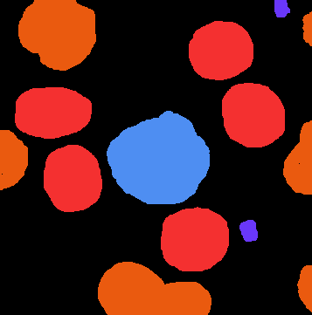
Problem 3: Ground Truth Images
(363,360,4)
Ground truth
Notes:
You see, not all ground truth images are the same either.
First off, ground truth images are not all the same format. Png and Tiff are frequent formats, because they allow for transparency, but the underlying arrays can also be different.
The ground truth images that had been created by the annotation software I used, produced an image with a shape of (363,360,4). (4 instead of 3 because of the transparency layer).
One of my error messages actually had value and said something along the lines of “expecting 5 channels and received 254”. I pulled the image into Visual Studio so I could use python and look at the underlying array. 360,363,4. Was it having a problem with the transparency layer? Yes, but there was more.
Hmmmmm. I pulled in one of ground truth images that I ran in my PRETESTs into VS and saw something interesting.

Slide 26

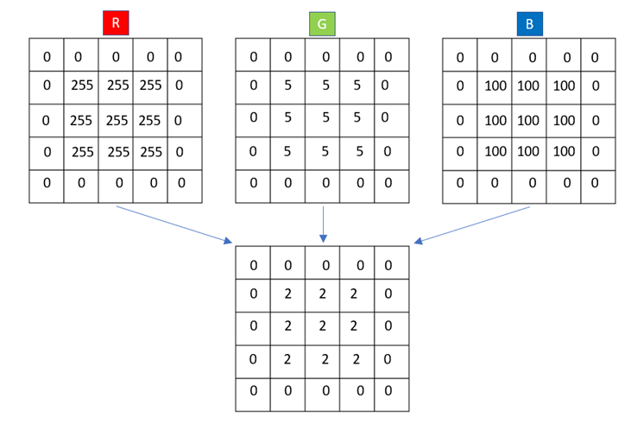
Changing Channels
(5,5,3)
(5,5,1) or (5,5)
Notes:
Going back to our 5 x 5 image example: Instead of that image shape of (5,5,3), or in our case with the transparency layer, (5,5,4) what I saw with the already tested images was an image shape of (5,5).
And this reminded me of when I was trying to look at the matlab ground truth images I had created during my annotation software exploration. And I remembered realizing that the numbers represented in the (5,5) shape – like the 2s in the bottom box here, instead of equaling a combination of colors, it was representing the actual class it belong to. So I went back and verified that every combination of numbers where the shape had that 3rd axis, translated into a specific class. It did! So I wondered out loud “can I just flatten this out?” Change the shape and replace with a class number for each combination? Turns out, the answer is YES! By flattening the three blocks you see at the top, to the one block you see at the bottom, the array has a singular number representing each block in the 3x3 square. In this process, the square's number is set to have a class label of 2 and the shape of the array changes to (5,5). This is what my network was looking for.
By flattening my ground truth images to the shape to (363,361) a singular value was given to denote the class of each object with one of the 11 class labels I was using. Note THIS IS NOT THE SAME AS the CONTOUR image we were talking about earlier. I’m changing this top row that has that last axis as a 3, that we call channels, to 1 channel that you see at the bottom. And this was because my project needed the ground truth images to have the lower shape instead of the one at the top.
New lesson learned for Problem 3: Know the requirements of your ground truth images for your project.
BTW: if you ever have to do this for a CV project, which wouldn’t be surprising, if you try to open your newly saved image up in traditional image software. Your image may end up looking like this.

Slide 27

Changing Channels
Notes:
Don’t panic! Regular image viewers really want to look at it like it’s a color and that black value of 0 is just too close to our class numbers 1-11. If you want to see what it looks like then pull it into Matlab or python using a matlab library – or some similar process.

Slide 28
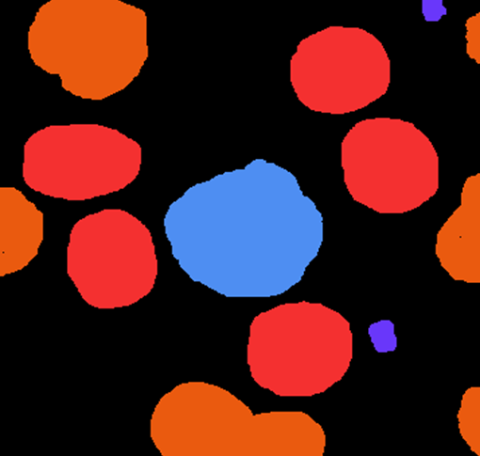
Changing Channels
Notes:
The it will go back to looking like you expected. Maybe not the exact colors you expected, but different colors for different channels. The colors are really just for your human eye benefit.
Finally, we could run our images through our networks and get some results.

Slide 29
Problem 4: Data Splits
split | # images | train | test | val
80/10/10 | 114 | 90 | 12 | 12
70/15/15 | 114 | 80 | 17 | 17
60/20/20 | 114 | 68 | 23 | 23
Notes:
Before we get into the results, I want to step back now and talk about those splits from the beginning.
Recall we had 114 images and we also need to split those into different sets. Looking at those original splits and accounting for decimals, this is really what the splits broke down to.
And if you are fast at math, you’ve probably already noticed that line 1 isn’t exactly right, but the decimals in this situation made the splits a little wonky, so we kept the split as close as we could.

Slide 30
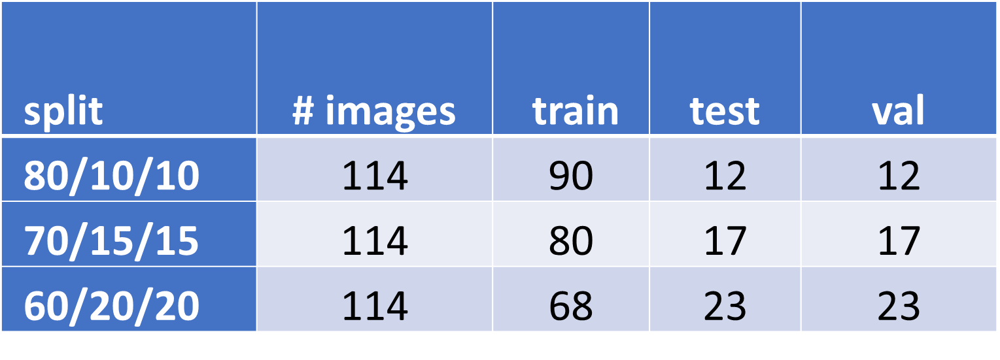
Problem 4: Data Splits
Notes:
Now, not every image has every object class. In fact, most images had 4-5 classes in it. Which is why you would see about 4-5 colors in the ground truth images.
All of them had some classes: background and the 2 classes for red blood cells. Sometimes they even had some of those tiny platelets, and then usually one of the other 7 classes. Listed as 2-8 here.
So really those numbers for splits started to look abysmal. In fact, that really meant some classes may be represented in only one or 2 images in these splits. That certainly wouldn’t be enough to train on, and not much better with it being on your test or validation side. But let’s hold that thought for a minute.

Slide 31
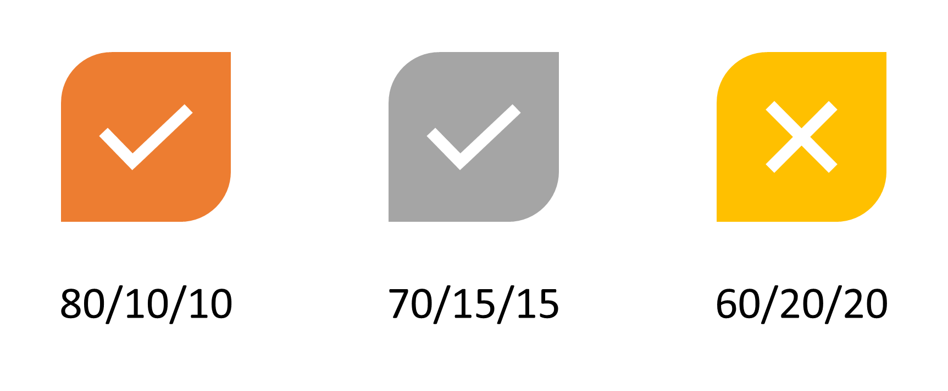
Problem 4: Data Splits
Notes:
What I realized right away, was that from a training perspective, that 60/20/20 wasn’t not going to be helpful. Just too low of a number to even consider for training sets. Each split I used had to be run through each network – which is time consuming. I hadn’t tested everything end-to-end with evaluating metrics, so using reasonable judgement to cut one of these made it easier for me.

Slide 32
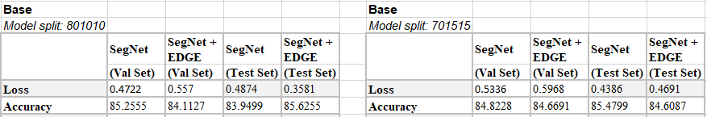
Initial Results
Notes:
And these were my initial results. Very unexpected. My loss wasn’t bad and my accuracy was nothing to sneeze at.
Accuracys in the mid-80 percents.
Accuracy as used here let me know how often my model’s prediction for a pixel was right.
Loss just helps you to understand how much the predicted value differ from the actual value. If the model's prediction is perfect, the loss is zero; otherwise, the loss is greater. It’s not like accuracy where you would cap out at 100%, so your loss can actually exceed 1 (or even way more). If you look at the comparisons of splits here, My loss numbers were a little higher in my 70/15/15 split, so that meant there was a little bit more error there.
Looking at this first run of results I thought:
“Wow. I AM AMAZING. I’ve finally got this SO under control.“

Slide 33
“If you are not prepared to be wrong, you will never come up with anything original.” - Sir Ken Robinson
Notes:
This may be a good time to throw one of my favorite quotes in here.
“If you are not prepared to be wrong, you will never come up with anything original.”
And BOY WAS I WRONG.

Slide 34
Anatomy of an image
Notes:
What happened is that my classes were unbalanced.
If you look at this ground truth image – what do you see most of? Black. Background. So my model got really good at learning and identifying background.
What else do you see? A lot of orange and red. Which represented single rbcs and rbcs that overlapped or were off the edge of the image.
We also see some tiny platelets and then 1 large Basophil blood cell. Which by the way, as we said, was only in a small number of the images. Background and RBCs are in every image, but not the other classes. So our model had fewer chances of learning the other classes, but got really really good at learning the things that dominated each image AND were IN every image.
Using Accuracy as my metric wasn’t going to work here. It was right 85% of the time because look at how much of this image it could learn from each time.
SO I had to find a different metric.

Slide 35
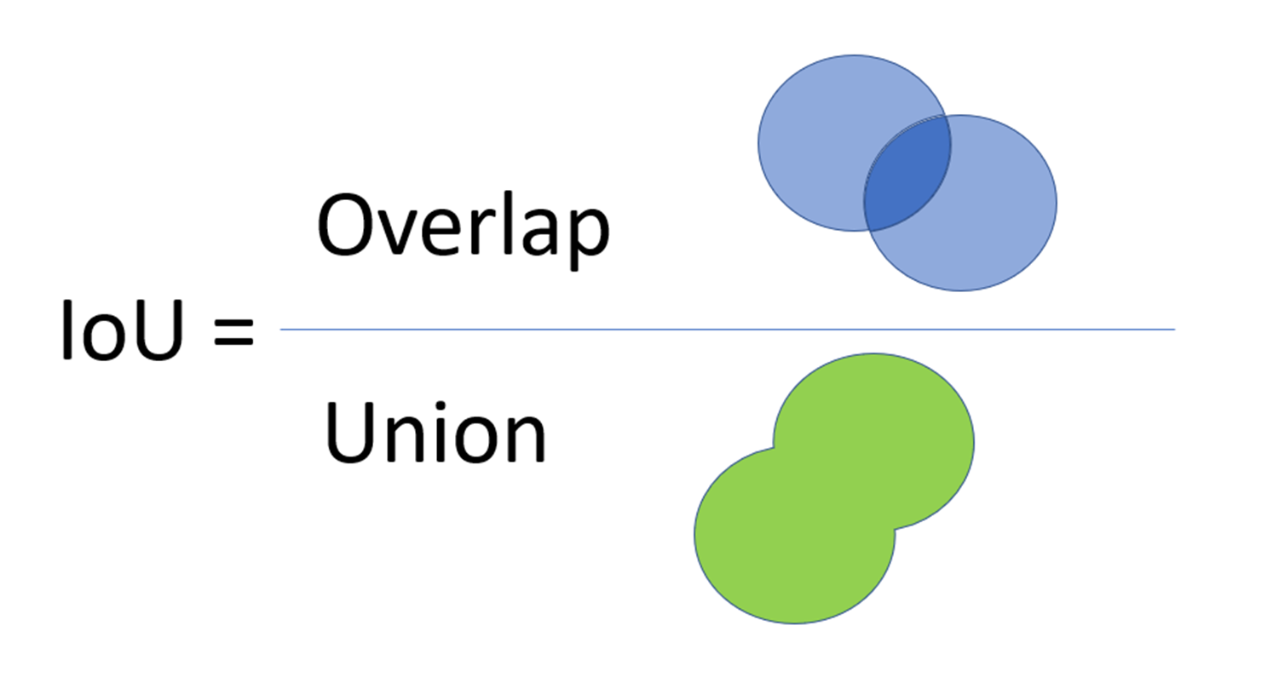
New Metrics
Notes:
Using another metric called Intersection over Union (IoU). I was able to get a better picture of what was going on. It is an evaluation metric used to measure the accuracy of an OBJECT DETECTOR on a particular dataset.
With IoU, you use the ground truth mask and the prediction mask. Then you see how close those two masks overlap (aka intersect). If the masks overlap exactly, then they are the same as the union of the mask, so when divided, the IoU = 1; if they do not overlap at all, then in this formula the IoU = 0. Usually you have something in between.
By using this metric, I could get a better idea how each class fared.
With this slide I’m showing you what the correct metric for MY project was and you don’t need to memorize this specific metric, because really the big takeaway is that you need to make sure you are using the RIGHT metric for your project. And that’s not exclusive to CV – those of you in analytics have probably dealt with this before.
------------------------------
Tiu, E. (2020) Metrics to Evaluate your Semantic Segmentation Model, Medium. Available at: https://towardsdatascience.com/metrics-to-evaluate-your-semantic-segmentation-model-6bcb99639aa2 (Accessed: 4 May 2021).

Slide 36
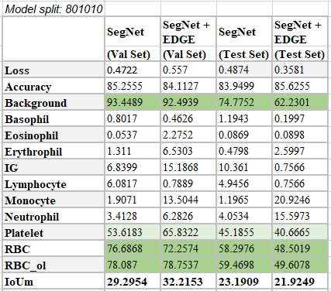
Initial Results
Notes:
Here is the breakdown of classes using IoU. Although again, not the same as accuracy, you can see how they can have a strong influence on that original accuracy metric.
By the way, the platelets had small examples like you see here, and then also larger examples in other images. So that’s why you see a middle of the road metric here for platelets.

Slide 37
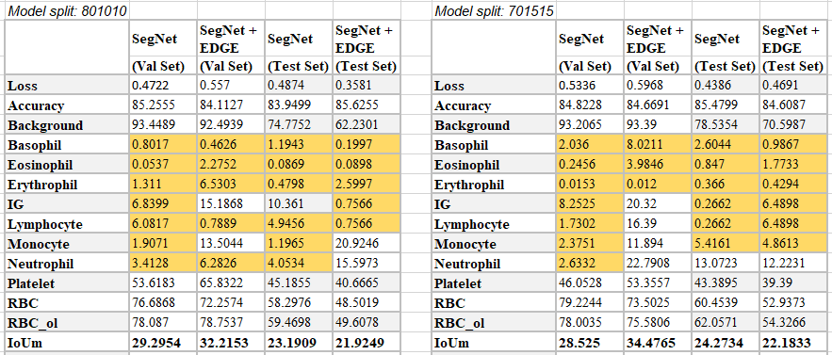
Initial Results
Notes:
And this is the initial results with the two different splits.
With our remaining classes, arguably the most important ones, we can see how dismal our predictions are.
Even when you compare the different model splits, I don’t think I had ever seen metric results so low.
So what to do? I had 3 weeks left to finish my project, write a paper, and then afterwards have 1 week to make it all into a nice presentation for the Capstone committee.

Slide 38
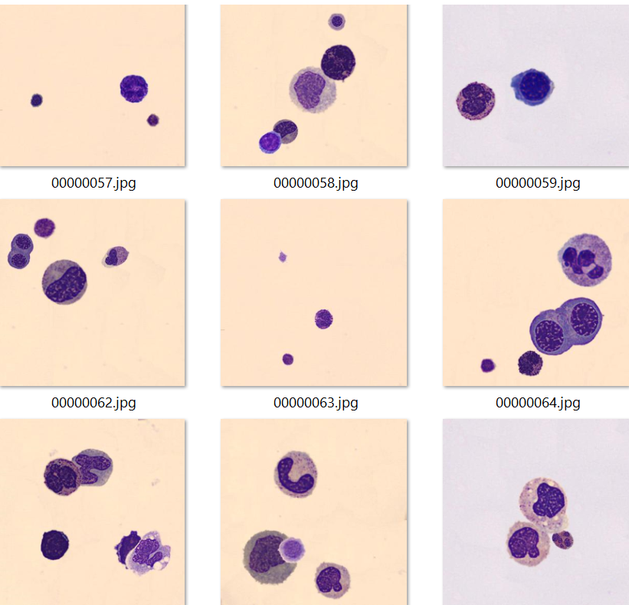
Synthetic Data
Notes:
Go big or go home.
With no experience CREATING a synthetic dataset, I decided this would save me from all things horrible in my mind. Nevermind I probably could have closed the project with a simple “well here’s what I learned”, I REALLY REALLY wanted to see something with more meaning in my results. Because the numbers I had so far were pretty meaningless and arguably could have changed dramatically when done in multiple runs.
What I DID know was that synthetic datasets – datasets that use real objects from other images to create new ones – showed a lot of promise in the field of computer vision. Fortunately the rabbit hole for this one wasn’t too bad. I stumbled on a website from Immersive Limit, that led me to the authors github page. I sprung for the extra few bucks for the corresponding tutorial on Udemy. (I highly recommend it by the way if you are ever faced with having to create a synthetic dataset on the fly. It’s amazing. ) . Additional bonus: the author’s code generated ground truth images and annotations, sooooooo – I was all in.
Now I did still run into some issues, because of course his project wasn’t exactly like mine – he used instance segmentation and if you recall I used semantic -, but the short of it was, after 1-2 weeks of flipping between that and working on my paper, I was able to generate all that I needed. By combining it with my base set, I ran with a more balanced representation than I previously had used, although I used 0 rbcs because of their density in my base set.
I created 1800 images and combined them with my original base set of 114. 1800 was chosen, because you do have to do some time-consuming masks of images that your synthetic dataset generation process will use to create the new synthetic dataset. It will randomly choose those individual image masks from a pool, make some changes to them, and then randomly place them on a background. The images you see here are some of the actual images that were created in the generation process. Pretty cool.
You would probably never have a lab slide of cells that look like these combinations, but it turns out that computer vision doesn’t really care. It’s just learning what those different objects can look like in different scenarios.
You don’t need fancy software to create this. Just GIMP and a python IDE.
So after that was done, the ENTIRE process was run again.

Slide 39
Results
 | SegNet | SegNet + EDGE | SegNet | SegNet + EDGE
 | (Val Set) | (Val Set) | (Test Set) | (Test Set)
Loss | 0.2742 | 0.3889 | 0.2607 | 0.3341
Accuracy | 93.2704 | 91.9911 | 91.0738 | 91.8879
Background | 97.8084 | 94.6816 | 95.7375 | 94.2119
Basophil | 14.538 | 13.2722 | 8.9027 | 2.7757
Eosinophil | 31.2126 | 26.8891 | 43.2296 | 32.594
Erythrophil | 8.7142 | 16.1332 | 5.0236 | 14.6106
IG | 9.4065 | 30.2469 | 9.3827 | 17.7288
Lymphocyte | 14.7109 | 23.7224 | 9.3666 | 17.7288
Monocyte | 25.7398 | 33.9071 | 23.3619 | 31.7164
Neutrophil | 26.04875 | 71.4724 | 13.8273 | 44.5503
Platelet | 19.5127 | 20.8977 | 0.7278 | 15.2304
RBC | 0.3531 | 0.0955 | 0.4349 | 0.0475
RBC_ol | 0.5145 | 0.176 | 1.3301 | 0.0791
IoUm | 22.5963 | 30.1358 | 18.4702 | 24.3367
Adjusted Mean | 27.521317 | 36.802511 | 23.284411 | 30.127433
Notes:
While not ideal results, this was looking much better. And remember that our main goal was not to have the highest metrics as possible. Our goal was to see if there was a notable difference when you added a fourth channel. Good or bad.
So while the results were still pretty low in some cases, what we do see is that there is significant movement with adding the fourth channel. Especially for some reason with Neutrophil.
And looking at our DRASTIC drop in RBC classes, we also have learned a final lesson – in that class balance makes a difference within individual images, as well as across an entire set.
So if you look at the IoUm here and even better yet the adjusted mean – which throws out the bad RBC classes – you can get a better idea of that change between the networks.
One of my final recommendation for this project was to increase the synthetic set by way more, which could be done reasonably within a couple weeks on the side. That wouldn’t make my timeline, but I had my answer that I could present and finalize in my very large paper.

Slide 40
Recap
Problem 1: Annotations
Problem 2: Neural Networks are not Plug and Play
Problem 3: Ground Truth Images
Problem 4: Data Splits
Problem 5: Choose the Right Metric
Notes:
Problem 1: Know what you need with your annotations and know what you are getting. That includes knowing if there are any downstream process dependencies.
Problem 2: Not all neural networks are plug and play. There is a big dependency on the actual images and you need to know what those are in advance. Maybe it is size, maybe it’s something specific with ground truth images, maybe it’s something else. But knowing what those things may be, can save you a lot of headaches.
Problem 3: Not all ground truth images are the same. This ties into Problem 2, but take a moment to pull your ground truth images into python and see what is under the covers. One, it’s actually kinda cool, but two, it gives you an idea of the shape and really thinking in the space of how that shape applies to the images.
Problem 4: Data splits : choose the right data split for how many images you have. This really may be better titled as make sure you have enough data. Computer Vision needs a lot of data. There is not a specific number but I can tell you that 114 is not the right number. Ideally you will have over 10k, but again, that really depends on what you are doing.
Problem 5: And I’ve found this holds true for a lot of machine learning tasks: make sure you choose the right metric. If you are not sure, try different ones out and do some background research on what the best metric is for the task you are doing.

Slide 41
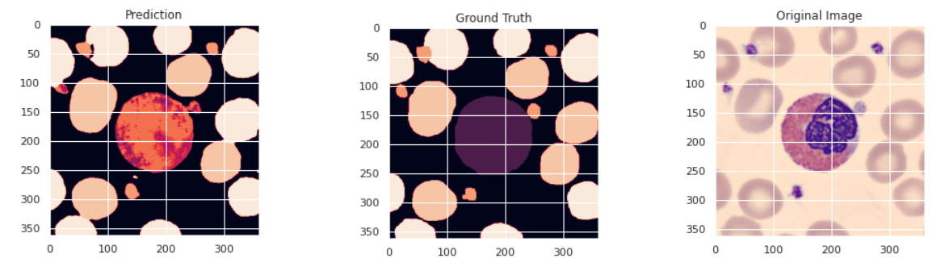
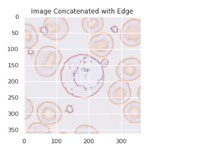
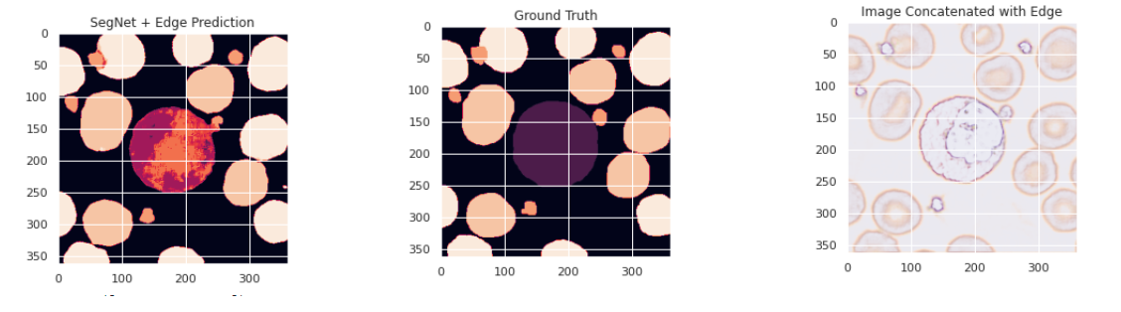
Predictions
Notes:
Some fun stuff now.
Here is an example real image and prediction between the base network and the one with the fourth channel. They are pretty similar with the prediction on everything else, and the goal is to look as close as to the ground truth as possible. I think that center blood cell is a basophil, and you can see where it has more purple leanings, and a little stronger on the small platelets.
Something funny here I noticed when doing my paper. I don’t think I brought it up though. If you notice the ground truth has this RBC as peach, and both predictions have it as cream. That ground truth is actually labeled wrong. It’s just hitting that edge, and I should have labeled it as rbc_ol, which is cream in color. And THE MODELS CAUGHT IT. One of the often-cited benefits of neural networks is that when a human labels things they may make mistakes because of fatigue or other issues. With a neural network you don’t really have that. This was kind of a real live example of that for me.

Slide 42
Notes:
Lastly, and mostly because I thought this was super cool - here is a comparison of how the networks learned on different iterations (called an Epoch).
At the beginning, the SegNet learning is super fuzzy, compared to the Integrated network with first some pretty immediate identification of objects. <animate>
But then later the integrated network, at least for this image, seems to have some issues in some places, though the tiny platelets are better.
Putting this presentation together reignited my desire to go back and explore this a bit more and clean everything up for GitHub. And hopefully I’ll have those updates soon for those of you interested.

Slide 43
The End
Most projects are not groundbreaking successes but may still provide you with valuable information.
Notes:
One the biggest things I’ve learned in my AI journey, is that most projects are not groundbreaking successes. Especially at first or second go at a project. Whether that is school or work or obsessive hobby (COVID people – you know who you are)
Everyone wants to be on the cutting edge, but don’t let that make you miss the most important lesson: does your project provide you with valuable information. Because that is really what the ultimate goal is.

Slide 44
Resources
My github: https://github.com/kdmishraISU/NewStarsOfData
Blood Cell Dataset: https://data.mendeley.com/datasets/snkd93bnjr/1
Immersive Limit (for synthetic dataset): https://www.immersivelimit.com/tutorials/create-coco-annotations-from-scratch
VGG Image Annotator: https://www.robots.ox.ac.uk/~vgg/software/via/
GIMP
https://www.gimp.org/
Notes:
Here are the resources mentioned in this presentation. My paper is also available in my github If you are interested in all the details.
I think we have a few minutes left for any questions.

